Slide 1
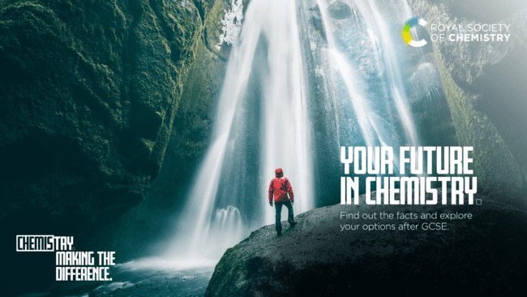
Find out the facts and explore your options after GCSE.

Slide 2

About me
A future in chemistry
Brief intro here
Where I work
Company name to go here
What inspired me to choose my career here
What is the ‘impact’ of what I do here
Sub header here
Sentence describing what I do
Sentence describing what I enjoy about it
Sentence describing why I love it

Slide 3
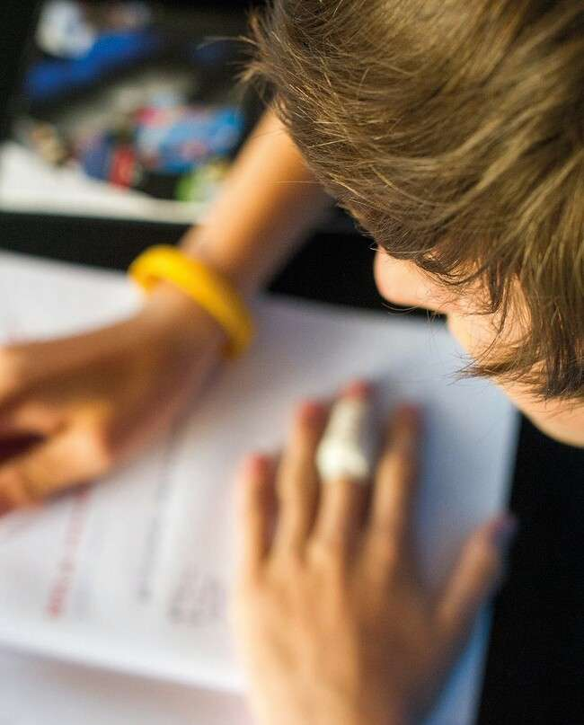
About you
A future in chemistry
Don’t know what you want to do? That’s ok!
First step: get to know YOU by asking yourself a few questions What do you enjoy?
What’s important to you?
How much science do you want in your life?
How much studying do you want to do when you leave school?
Have you ruled anything out? Why?

Slide 4



Where do you want to work?
A future in chemistry
In education?
Part of a shared-interest-community, teaching courses, self-directed research, publishing papers
In industry?
Competitive salaries, working on company goals, deadline-driven, careers in different areas across the business
In a small company?
Fast-paced, more responsibility, learn on the job, opportunities to rise fast and develop a range of skills

Slide 5

Now write down:
A future in chemistry
What you enjoy
What’s important to you
One or two jobs you’ve ruled out – and why

Slide 6


Slide 7
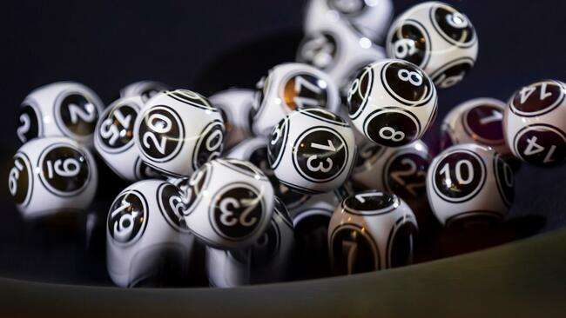
Career quiz
Fill in the questionnaire*
It’s just for fun!
This quiz should show that studying chemistry could take you into so many different areas of work. It’s not designed to tell you what you should or shouldn’t want to be!
*answer the questions on the next slide or on a print-out

Slide 8
Where could chemistry take you?
A future in chemistry
1
What sort of work do you like the sound of most?
3
What do you love doing in your spare time?
5
You’d think your life was a success if you:
A. Working with your hands | A. Building things, arts and crafts | A. Cured a disease
B. Working with numbers and data | B. Puzzles, strategy games | B. Earned a lot of money
C. Helping others | C. Meeting lots of different people | C. Made a lot of people’s lives better
D. Problem solving | D. Reading the news, discussing politics | D. Fixed some of society’s biggest issues
E. Something creative | E. Reading books, listening to music | E. Could express yourself
2
4
Apart from science, what subjects at school do you like most?
6
Pick the word that most closely describes what you’d like the world to be in 10 years’ time:
What’s your biggest strength?
A. Your attention to detail | A. Art / textiles / design tech | A. Healthy
B. Thinking logically | B. Maths / ICT / computer science | B. Prosperous
C. Getting on with different types of people | C. Health and social care / sociology | C. Happy
D. Working through problems | D. History / politics / geography | D. Harmonious
E. Your imagination | E. English / music / media | E. Radiant

Slide 9
Check your answers
Check your scores and find the most relatable jobs
A future in chemistry
Mostly As |  | Mostly Cs |  | Mostly Es
Researcher |  | Teacher |  | Games designer
Medicinal chemist |  | Doctor |  | Food scientist
Cosmetic scientist |  | Vet |  | Science journalist
Biochemist |  | Nurse |  | Art restorer
Material scientist |  | Midwife |  | Chef
Oceanographer
Mostly Bs
Mostly Ds
Tax accountant
Forensic scientist
Patent attorney
Science policy advisor
Systems analyst
Politician
Software designer
Environmental scientist
Conservationist
Seismologist

Slide 10

As a chemical scientist you could be…
A future in chemistry
Making a difference to life through drug discovery, and combating antibiotic resistance
Developing ways of removing plastic waste from the oceans
Reducing pollution, and discovering ways to harness and store energy using clean, green power

Slide 11

Where do chemistry-using professionals work
A future in chemistry
Just some places where Royal Society of Chemistry members work (2017)
5%
8%
Energy and the environment
Hospital, local and central government
32%
University research
9%
Teaching in schools
10%
IT / computers, publishing other service industries
16%
Medicines and drug research
20%
Consumer goods and other manufacturing

Slide 12
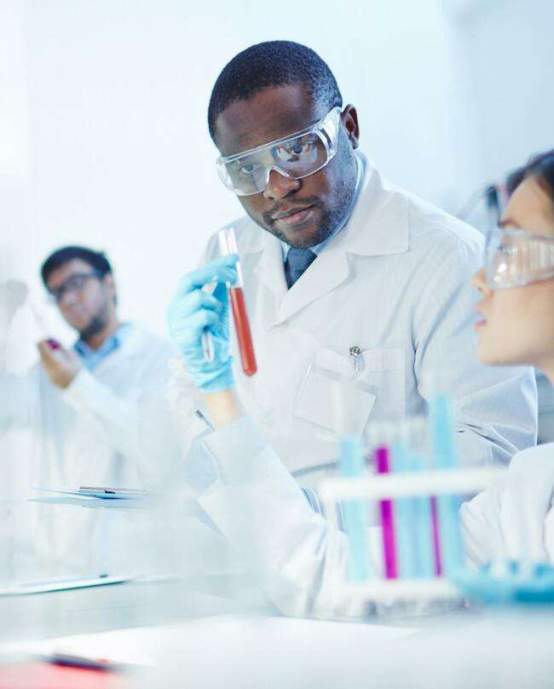
Chemical scientists are well paid
A future in chemistry
Chemistry graduates get 15% higher starting salaries compared with the average for graduates
Chemistry graduates have a high employment rate
70%+ of chemistry students enter a professional or managerial role after graduation
Double the UK average of graduates go into further study
There are ~275,000 chemistry-using professionals in the UK (2019)
Chemistry-using professionals contribute an enormous £87 billion to UK GDP (2019)

Slide 13

Chemical scientists have the skills employers look for!
You’ll learn skills for being successful in the future, such as:
A future in chemistry
Numerical ability and computational skills
Problem solving
Logical thinking
Teamwork
Reasoning
Communication skillls

Slide 14

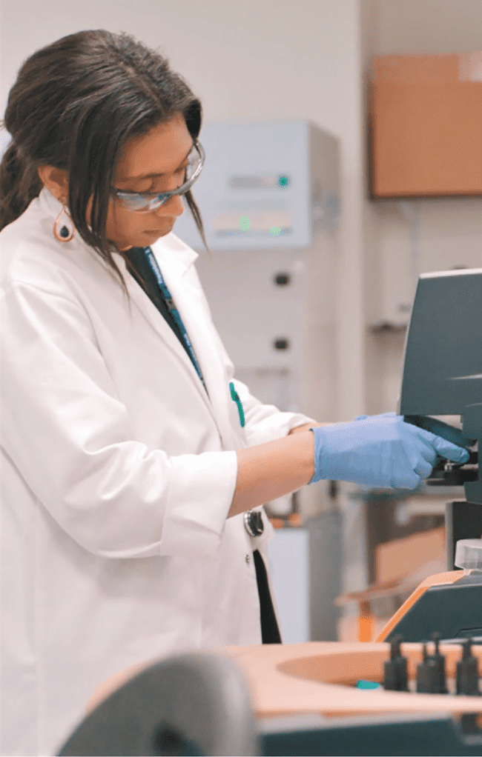
Take chemistry and you could become…
A future in chemistry
An analytical chemist
You’ll be checking what’s in substances
– for example, breath samples, or blood at a crime scene.
A lab technician
You’ll collect samples, analyse and carry out tests on chemicals, materials or products.

Slide 15

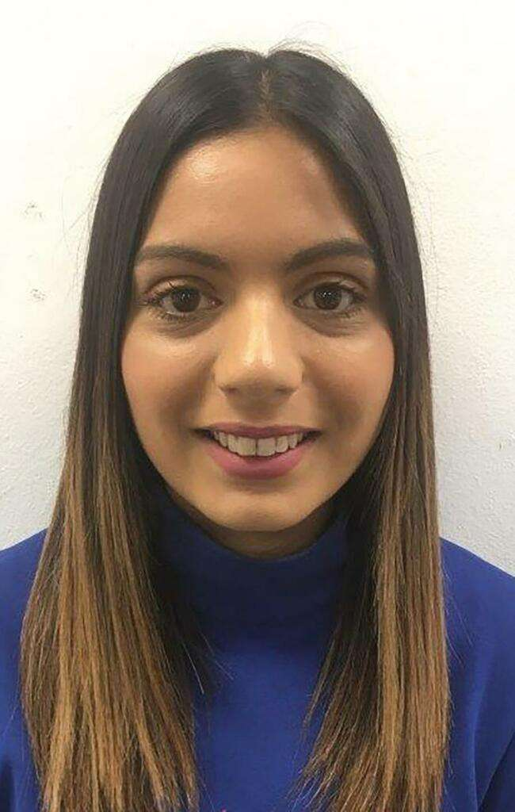
Take chemistry and you could become…
A future in chemistry
An associate scientist
You’ll design and develop medicines to treat diseases.
A development chemist
You’ll develop things that are made from chemical reactions, such as inks, makeup and fertilisers.

Slide 16

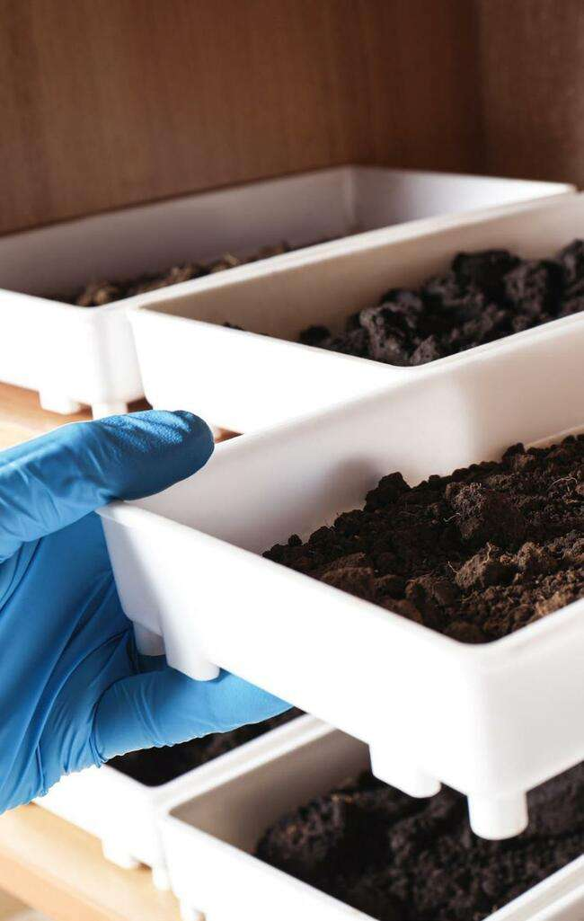
Take chemistry and you could become…
A future in chemistry
A research chemist
You’ll study substances to find out the best ways to make products
such as new medical treatments, makeup, electrical goods, food and drink.
An environmental chemist
You’ll find out what’s in the air, water and soil to understand our world better and how humans affect it.

Slide 17
So… what else you can do with chemistry?
From teaching and writing, to the law and banking, so many employers value a chemistry qualification. One chemistry graduate even went on to be Prime Minister!
A future in chemistry
Teaching
You could enter
Medicine
Financial services
Computer science
Chemical engineering
Law
Business / management
Veterinary science

Slide 18

…all employers and sectors value chemistry!
A future in chemistry
You could:
Become a doctor
Advise on science policy Analyse data for reports
Help people protect their ideas
Sell scientific equipment
Become a science communicator

Slide 19
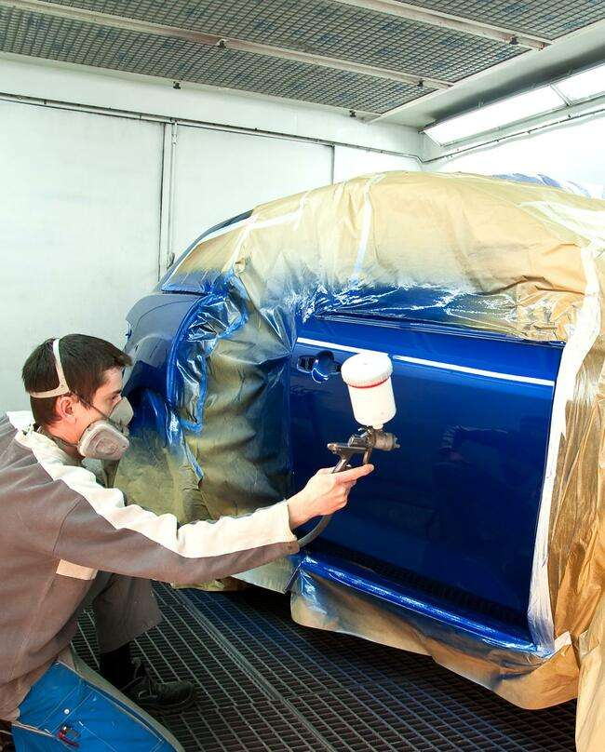
Some of the ways chemistry is used at work
A future in chemistry
Analytical chemists use chromatography to check human samples and meet anti-doping laws.
Automotive chemists use electrolysis to coat vehicles with metal to make them last longer and look good.
Food scientists use titration to discover the amount of salt or sugar in a product or the concentration of vitamin C, which can affect the product’s colour.

Slide 20
Where can you work with a chemistry qualification?
A future in chemistry
Manufacturers
Making drugs, food,
energy, materials, polymers, biotechnology, paint or chemicals
Testing company
You could work at a
Environmental agency
Government agency
Public health laboratory
Hospital
Consultancy
University
Just about anywhere!

Slide 21

What surprised you about the jobs that are linked to chemistry? Tell the person next to you!
Now ask the same person:
“Tell me one thing that might be good for your future if you take a chemistry qualification”

Slide 22


A future in chemistry
How to get qualified
School Chemistry, physics, maths, biology, combined science,
computer science
✓
£
University degree Foundation degree (level 5) BSc / BEng (level 6)
MChem / MSc / MEng (level 7)
Sixth form / FE A-levels / T-levels / Highers / IB / BTEC /
TechBacc
Work-based learning Intermediate / Advanced / Higher / Degree Apprenticeship / HNC / HND
Work

Slide 23
Continue studying
A future in chemistry
BTEC:
level 3 in applied science (various options), flexible and equivalent to up to three
A-levels. Emphasis on vocational content. Progression to higher education, to an apprenticeship or entry-level employment in the science sector. Recognised by some universities: check admissions policy of
university
A-levels:
two-year curriculum study with final assessment. Emphasis on academic skill. Progression
on to higher education, to an apprenticeship or entry-level employment in the science sector.
Recognised by UK universities
International Baccalaureate Diploma:
two-year programme, academic. Progression to higher education, to an apprenticeship or entry- level employment in the science sector. Recognised by many universities worldwide

Slide 24

Combine study with work
A future in chemistry
Options:
Apprenticeships – suitable if you know what occupation you want to pursue, want to earn a wage and learn at the same time, and are ready to enter the workforce at age 16. 80% on-the-job, 20% in the classroom.
Higher National Certificates (HNCs) and Higher National Diplomas (HNDs) – work-related qualifications which are equivalent to the first year of a degree course (HNCs) or the first two years of a degree course (HNDs).
AT-levels – available 2021, equivalent to three A-levels, these two-year courses offer a mixture of classroom learning (80%) and on-the-job experience (20%) during an industry placement of at least 315 hours (approximately 45 days).

Slide 25

Now what? Find out more!
A future in chemistry
A future in chemistry
Your career starts here
Discover your future in chemistry at our careers website rsc.li/future-in-chemistry

Slide 26

Useful links
A future in chemistry
Teach chemistry: faces of chemistry: printable career profiles www.rsc.org/learn-chemistry/collections/faces-of-chemistry/ careers-with-chemistry
LMI for all: compare up to three careers
www.lmiforall.org.uk/widget
National careers service: browse 100s of roles nationalcareers.service.gov.uk/search-results? searchTerm=chemistry
#TeamScience: compare careers
www.teamscience.org.uk

Slide 27

Get some experience of a workplace
A future in chemistry
Why? You’ll find out about different jobs you’re interested in, expand your network, and gain experience and skills
Where to start:
Ask your career adviser, teacher and family if they know of chemical sciences
Get in touch with a local education business partnership
Browse Chemistry World Jobs or New Scientist Jobs. Although there may not be any ads for work experience placements, you’ll get ideas of what different companies do jobs.chemistryworld.com
jobs.newscientist.com/en-gb/

